Slide 1

WebRTC
HTTP/2 all the things!
challenges, opportunities, and the exciting world ahead of us...
+Ilya Grigorik
@igrigorik
Notes:
https://docs.google.com/presentation/d/1l9c9ROjLTD8clOL0yFufAOMbxNC0D-19zCiXMgqtY-M/present?slide=id.p19

Slide 2

Who’s this guy? :-)
Performance Engineer @ Google
Anything web perf related…
Wrote HPBN (read @ hpbn.co)
Radio → TCP → TLS → HTTP
Browser APIs: XHR, WS, WebRTC
…
Blog: igvita.com
Twitter: @igrigorik

Slide 3
$> telnet igvita.com 80
Connected to 173.230.151.99
GET /archive
Hypertext delivery with HTTP 0.9! - eom.
(connection closed)
HTTP 0.9 is the ultimate MVP - one line, plain-text “protocol” to test drive the “www idea”.

Slide 4
$> telnet ietf.org 80
Connected to 74.125.xxx.xxx
GET /rfc/rfc1945.txt HTTP/1.0
User-Agent: CERN-LineMode/2.15 libwww/2.17b3
Accept: */*
HTTP/1.0 200 OK
Content-Type: text/plain
Content-Length: 137582
Last-Modified: Wed, 1 May 1996 12:45:26 GMT
Server: Apache 0.84
4 years of rapid iteration later… eom.
(connection closed)
HTTP 1.0 is an informational RFC - documents “common usage” of HTTP found in the wild.

Slide 5
$> telnet google.com 80
Connected to 74.125.xxx.xxx
GET /index.html HTTP/1.1
Host: website.org
User-Agent: Mozilla/5.0 (Macintosh; Intel Mac OS X 10_7_4)... (snip)
Accept: text/html,application/xhtml+xml,application/xml;q=0.9,*/*;q=0.8
Accept-Encoding: gzip,deflate,sdch
Accept-Language: en-US,en;q=0.8
Cookie: __qca=P0-800083390... (snip)
HTTP/1.1 200 OK
Connection: keep-alive
Transfer-Encoding: chunked
Server: nginx/1.0.11
Content-Type: text/html; charset=utf-8
Date: Wed, 25 Jul 2012 20:23:35 GMT
Expires: Wed, 25 Jul 2012 20:23:35 GMT
Cache-Control: max-age=0, no-cache
100
<!doctype html>
(snip)
HTTP 1.1 ships as RFC standard in 1999 - hyper{t̶e̶x̶t̶}media all the things!

Slide 6


In the meantime...
Geocities ftw! (circa HTTP/1.1)
Web applications, not (just) pages.
Rich media and multi-device layouts.
Speed, performance and human perception

Slide 7
State of the HTTP nation...
12 distinct hosts per page
78 distinct requests per page
1,232 KB transferred per page
Resulting in typical render times of 2.6-5.6 seconds.
50th and 90th percentiles
* All numbers are medians, based on latest HTTP Archive crawl data.

Slide 8
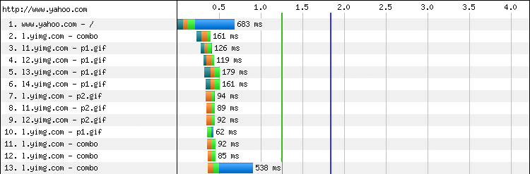
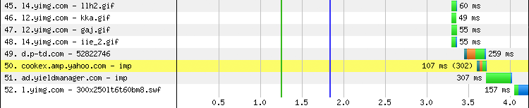
Yahoo.com waterfall… BW is not the issue?
… (snip 30 requests) ...
52 requests
4+ seconds
Primer on Web Performance (Chapter 10)

Slide 9
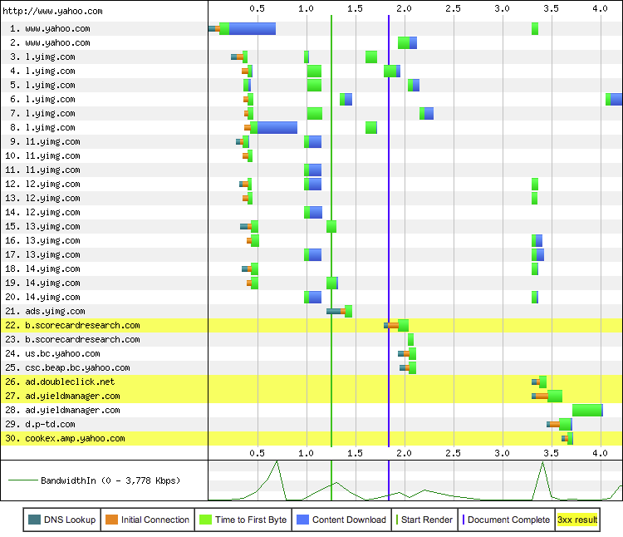
“Connection view” tells the story...
30 connections
DNS lookups
TCP handshakes
…
We’re not BW limited, we’re literally idling, waiting on the network to deliver resources.
Transfer time (in blue)
Speed, performance and human perception

Slide 10
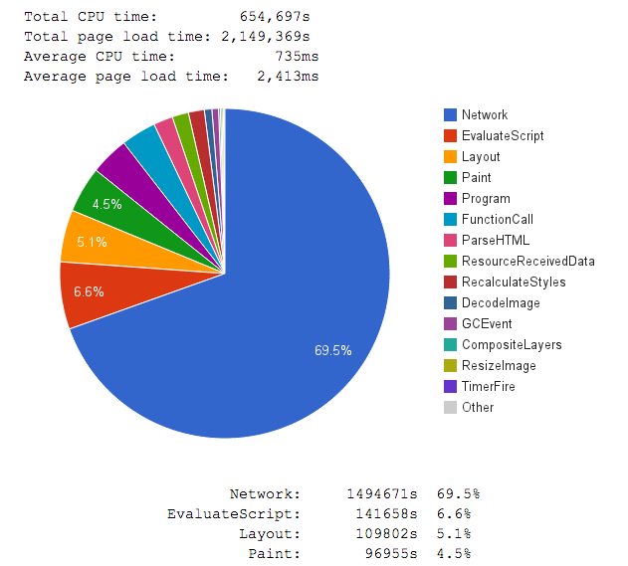
Top 1M Alexa sites...
Cable profile (5Mbps / 28 ms RTT)
Main thread attribution in Blink
Measured via Telemetry
69.5% of time blocked on network
6.6% of time blocked JavaScript
5.1% blocked on Layout
4.5% blocked on Paint
...
No surprises here... First page load is network (latency) bound!
blink-dev thread

Slide 11
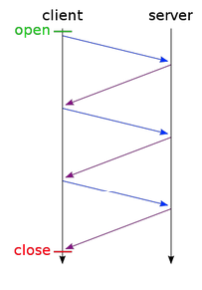
HTTP/1.1 performance problems...
Limited parallelism
Maximum of 6 requests per origin
Pipelining does not work in practice
Competing TCP flows, spurious retransmissions
Extra handshakes, FDs, memory buffers, etc.
Client-side request queuing
Head-of-line blocking
Delayed request dispatch
High protocol overhead
~800 bytes of header + cookies
No compression of HTTP metadata

Slide 12
Where there’s a will, there’s a way...
we’re an inventive bunch, so we came up with some “optimizations” (read, “hacks”)

Slide 13
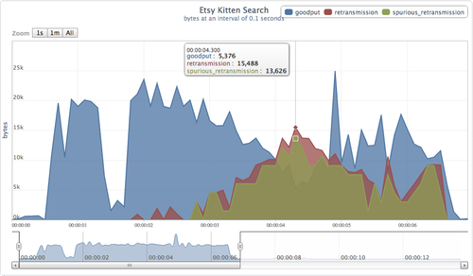
Domain shard… all the things!
6 connections per origin just add more origins, right?
Duplicate (spurious) data packets due to oversharding
Optimal number of shards? There is no such thing. Depends on particular page, device + network + network weather. Most sites overshard, and hurt themselves… Causing congestion, retransmissions, etc.
http://perf.fail/post/96104709544/zealous-sharding-hurts-etsy-performance

Slide 14

Concat… all the things!
“Reduce number of requests”...
Large monolithic code chunks
e.g. most pages use <20% of CSS rules
Expensive cache invalidations
e.g. single char update forces full fetch
Delayed execution of JSS / CSS
e.g. must wait for entire JS file to arrive
e.g. must wait for entire CSS file to arrive

Slide 15
Inline… all the things!
“Reduce number of requests”...
Duplicated resources
every page must embed the same resource
can’t use the HTTP cache
Breaks prioritization
inlined asset is “upgraded” to HTML priority
inflates the size of HTML document

Slide 16

Let’s fix HTTP instead?

Slide 17
Improve end-user perceived latency
Address the "head of line blocking"
Not require multiple connections
Retain the semantics of HTTP/1.1
"HTTP 2.0 is a protocol designed for low-latency transport of content over the World Wide Web"

Slide 18
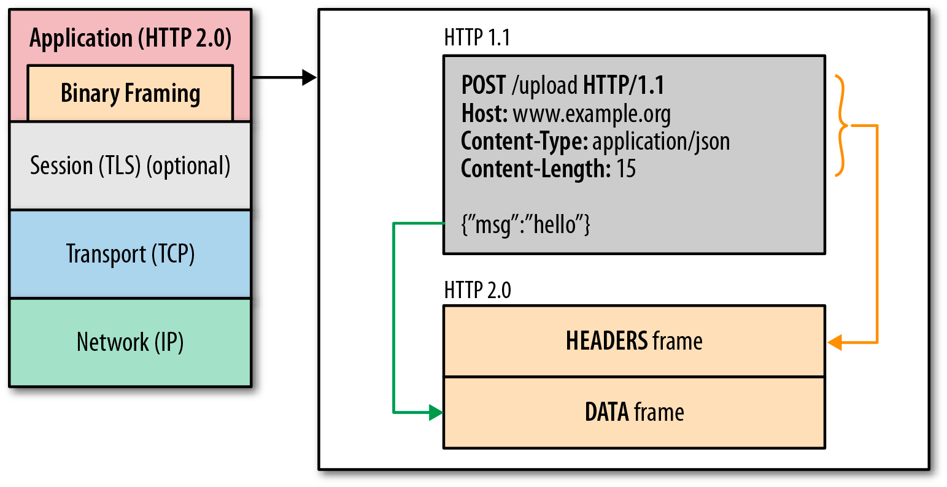
HTTP/2 in one slide…
One TCP connection
Request → Stream
Streams are multiplexed
Streams are prioritized
Binary framing layer
Prioritization
Flow control
Server push
Header compression

Slide 19
“... we’re not replacing all of HTTP — the methods, status codes, and most of the headers you use today will be the same. Instead, we’re redefining how it gets used “on the wire” so it’s more efficient, and so that it is more gentle to the Internet itself ....”
- Mark Nottingham (HTTPbis chair)

Slide 20
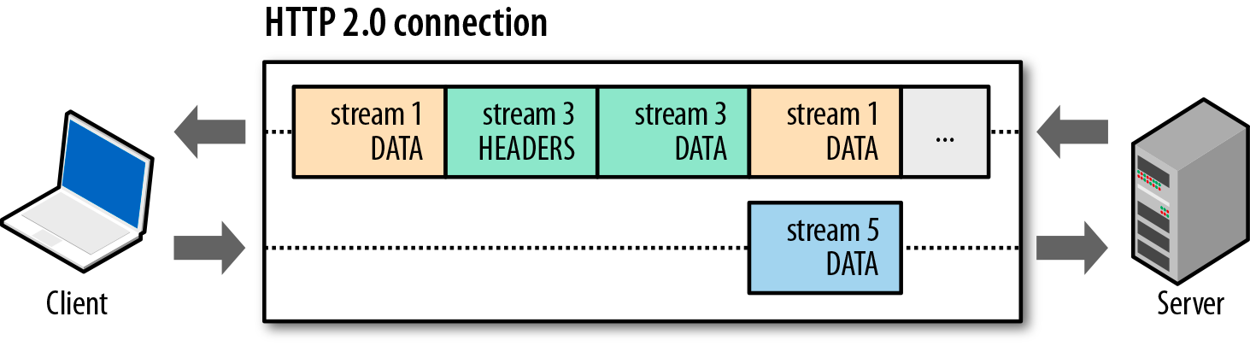
Basic data flow in HTTP 2.0...
Streams are multiplexed by splitting communication into frames
All frames (e.g. HEADERS, DATA, etc) are sent over single TCP connection
Frames are interleaved
Frames are prioritized
Frames are flow controlled

Slide 21
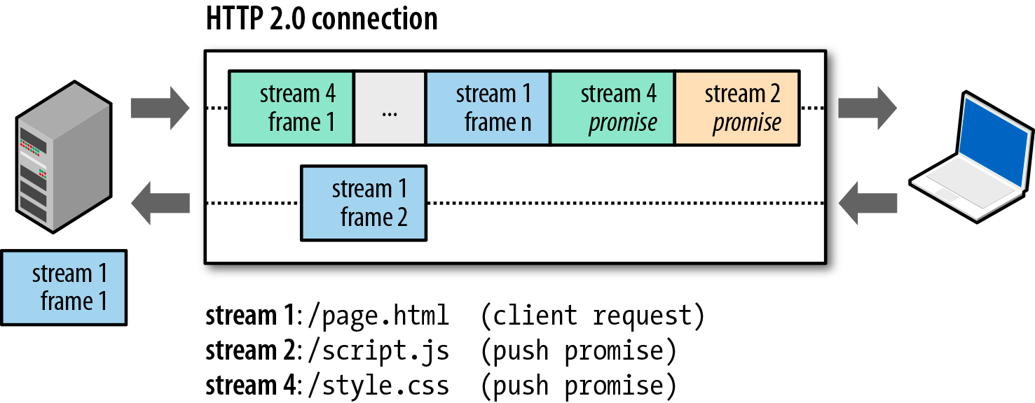
Server push… is replacing inlining
Inlining is server push. Except, HTTP 2.0 server push is cacheable!

Slide 22
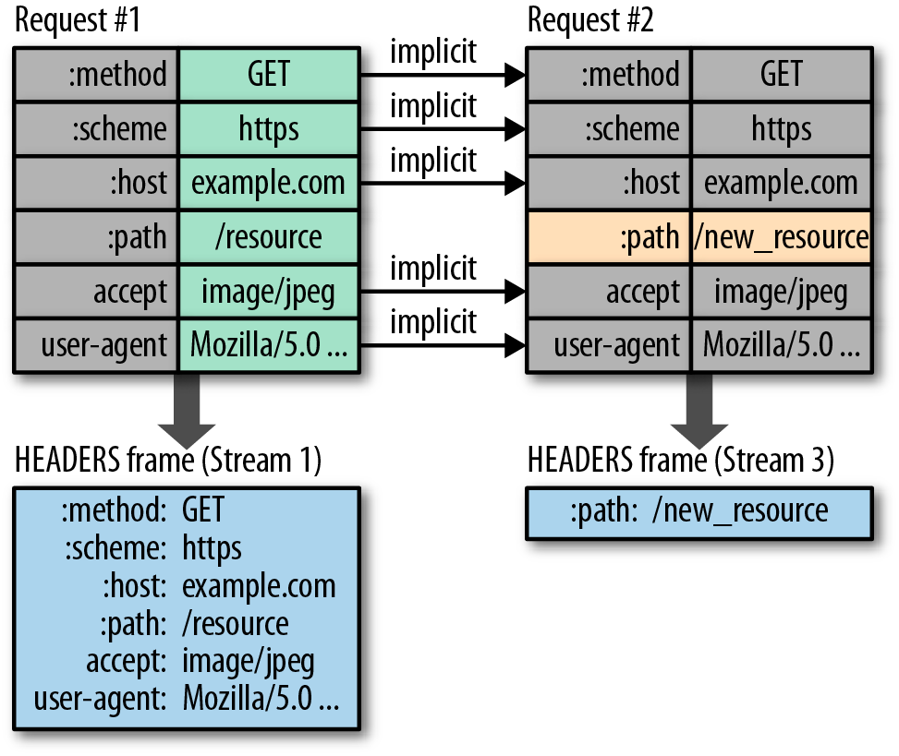

HTTP/2 header compression
Both sides maintain “header tables”
New requests “toggle” or “insert” new values into the table
Byte cost of new stream: 9 bytes! *
* as low as 9 bytes for an identical request.

Slide 23
But you already knew all that!
The more interesting part is how it changes web development...
min(request overhead) = 9 bytes
max(parallelism) = 100~1000+ streams
max(client queueing latency) = 0 ms

Slide 24
Remove domain sharding for HTTP/2
Sharding hurts HTTP/2 performance
Breaks prioritization, flow control, etc.
$> openssl s_client -connect google.com:443 |
openssl x509 -noout -text |
grep DNS
DNS:*.google.com, DNS:*.android.com, DNS:*.appengine.google.com, ...
Tip: use altName hosts to deploy domain sharding! *
HTTP/1.1 → opens new connection to each origin
HTTP/2 → reuses the same connection for altName origins
* Origin must be covered by the cert and resolve to same IP

Slide 25
Remove spriting / concatenation logic...
Streams are cheap, and no longer a constraint.
Deliver modular resources
aim to minimize resource churn
define granular caching strategy for each
Conditional delivery based on protocol?
Combine for HTTP/1.1 clients *
Granular resources for HTTP/2 clients
* Need better tools / infrastructure to do conditional delivery

Slide 26

Leverage server push instead of inlining...
Server can respond with multiple replies!
Client → I want /product/xyz
Server → Ok, and you’ll also need… style.css
Pushed resource is cached independently
Use “smart push”, don’t push on every request
Can remove RTT+ from critical path
Push… cache invalidations!
push a “tombstone” record to invalidate

Slide 27
Jetty’s “smart push” is a great strategy...
Server observes incoming traffic
Build a dependency model based on Referer
e.g. index.html → {style.css, app.js}
Server initiates push for learned dependencies
new client → GET index.html
server → Push style.css, app.js
Lots of room for experimentation + innovation!

Slide 28
Servers need to be *much* smarter
client is relinquishing a lot of control, badly implemented server → poor performance

Slide 29
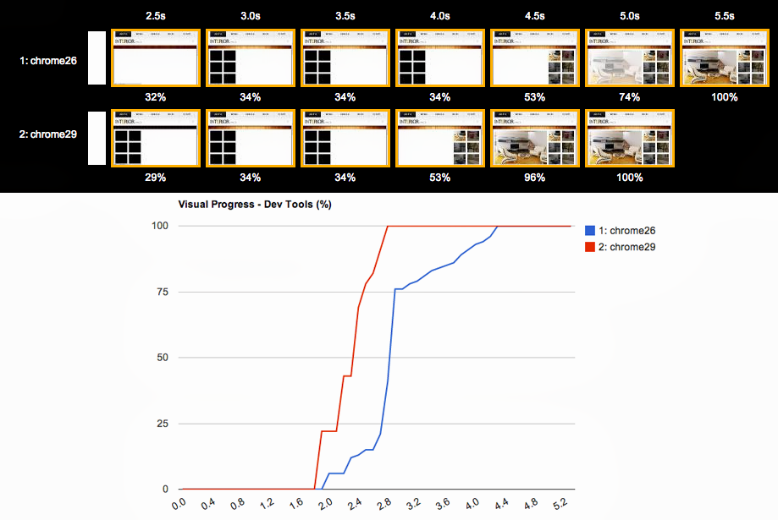
Chrome 28+ does not delay stream dispatch (yay)
“Don't delay low priority requests when SPDY is available. Check if the origin server supports SPDY. If so,
start the request immediately.”
Eliminates client queuing latency. Means the server must be smart about respecting client priorities!
SPDY resource scheduling
Notes:
+ Explain SPDY

Slide 30
Prioritization is key to optimized rendering...
With HTTP/1.1 browsers held back requests… not with HTTP/2.
GET index.html, style.css, hero.jpg, other.jpg, more.jpg, …
critical
low priority
Critical resources should pre-empt others
Poorly implemented server: saturate the pipe with static image bytes!
e.g. SPDY/v2 implementation in nginx did not respect prioritization, and performance suffered… test your server!

Slide 31
Smart++ server can optimize for each content type!
Don’t hold back all image bytes... send the first ~KB
Allows the browser to decode the image header and get dimensions
Allows the browser to minimize reflows during layout
Stream flow-control enables fine-grained resource control between streams. E.g…
T(0): I am willing to receive 4KB of kittens.jpg.
T(0): I am willing to receive 500KB of critical.js
…
T(n): Ok, now send the remainder of kittens.jpg.
Client controls how and when the stream and connection window is incremented!

Slide 32
Real-world performance...
Your gains will vary based on site architecture, server, clients, ...

Slide 33
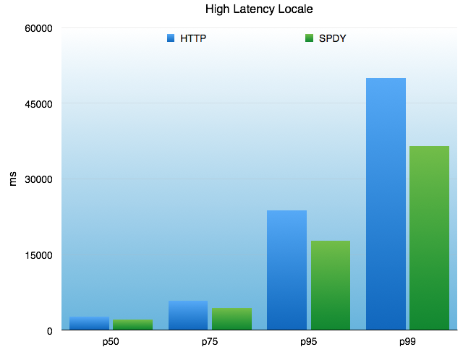
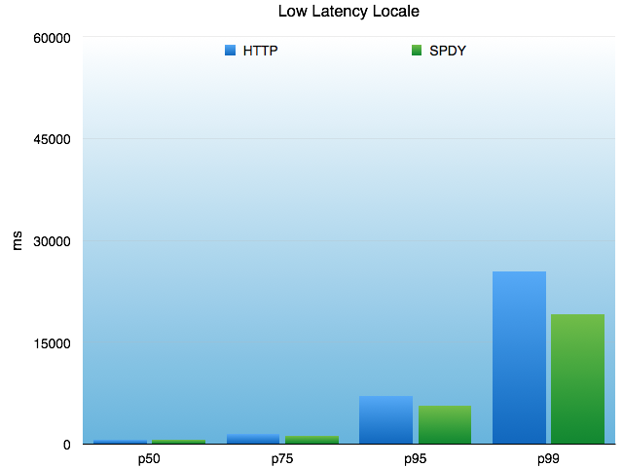
SPDY for API traffic @ Twitter
“However, we have measured as much as a 30% decrease in latency in the wild for API requests carried over SPDY relative to those carried over HTTP. In particular, we’ve observed SPDY helping more as a user’s network conditions get worse.” - Twitter
https://blog.twitter.com/2013/cocoaspdy-spdy-for-ios-os-x

Slide 34
HTTP/2 and SPDY
Page load time improvement with SPDY enabled...
 | Google News | Google Sites | Google Drive | Google Maps
Median | 43% | 27% | 23% | 24%
95th percentile | 44% | 33% | 36% | 28%
Improvement over HTTP/1.1 + TLS
http://blog.chromium.org/2013/11/making-web-faster-with-spdy-and-http2.html

Slide 35
“SPDY also has advantages on the server:
SPDY requests consume less resources on the server
SPDY requests consume less memory but a bit more CPU
SPDY requires fewer Apache worker threads”
Hervé Servy, Neotys.
Fewer connections means that...
s/SPDY/HTTP2/g … same results.

Slide 36
Speaking of TLS…
make sure your TLS stack is optimized!

Slide 37
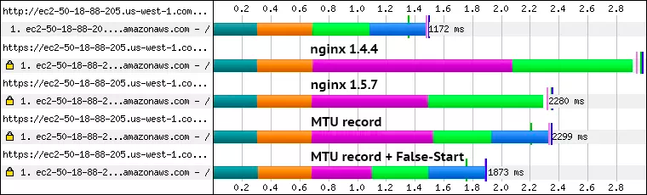
Tuning Nginx TLS Time To First Byte (TTTFB)
Pre 1.5.7: bug for 4KB+ certs, resulting in 3RTT+ handshakes
1.7.1 added ssl_buffer_size: 4KB record size remove an RTT
1.7.1 with NPN and forward secrecy → 1RTT handshake
https://www.igvita.com/2013/12/16/optimizing-nginx-tls-time-to-first-byte/

Slide 38
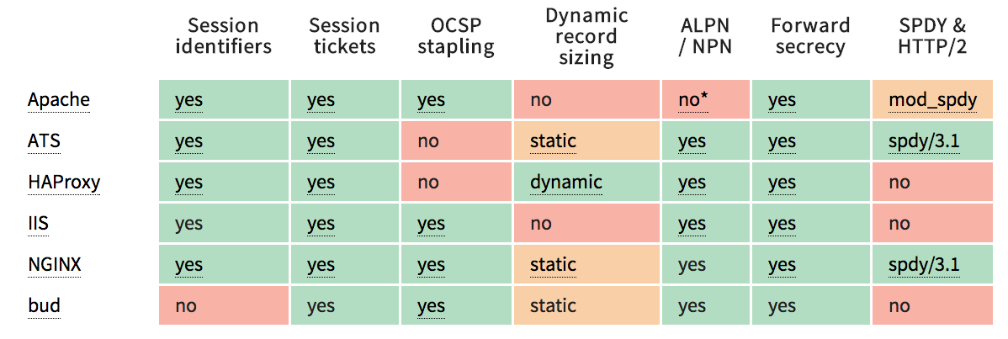
“Out of the box” TLS performance is poor… we need to fix this.
No server is perfect, plenty of work to be done to improve perf.

Slide 39
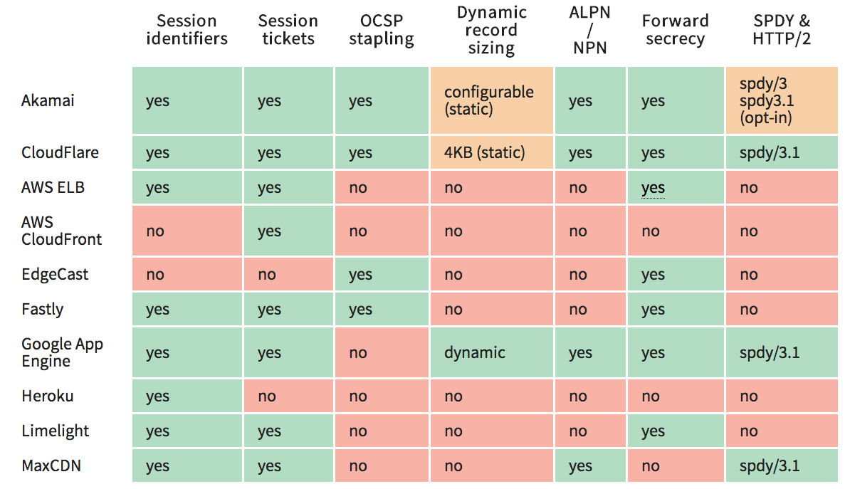
There is way too much red here… Bug your CDN about fixing this!

Slide 40
An optimized TLS deployment should...
Deliver 1-RTT handshake 100% of the time
TLS False Start for new visitors
TLS resumption for returning visitors
Ensure that server is able to send full cert chain without blocking
OCSP stapling to avoid blocking
Optimize data delivery
Optimize record size to avoid unnecessary buffering delays
Leverage SPDY / HTTP/2 to further reduce latency and ops costs
Leverage HTTP/2 optimizations: unshard, un-concat, etc

Slide 41
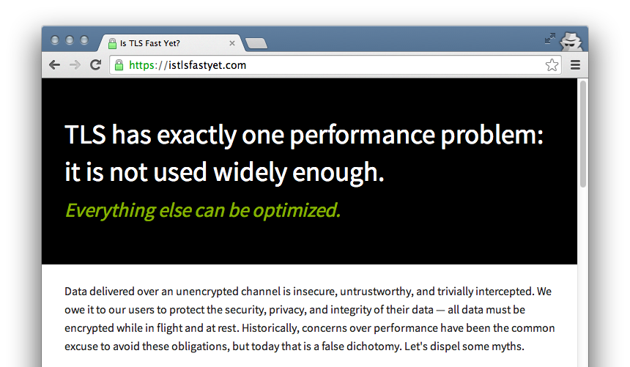
isTLSfastyet.com

Slide 42
Where to from here?
necessary steps to make HTTP/2 ubiquitous

Slide 43
Browser support is there, or coming soon...
Chrome M39 is shipping HTTP/2 (draft 14)
Coming in next stable release! Available in Canary today.
Google servers are also speaking HTTP/2
Firefox 34 is shipping HTTP/2 (draft 14)
Coming in next stable release!
IE supports HTTP/2 on Windows 10 Technical Preview
In the meantime, IE also supports SPDY v3
Latest Safari suports SPDY v3
No official HTTP/2 announcements, but… I’m sure its coming.

Slide 44
Wait, what about SPDY?
SPDY was “experimental branch” of HTTP/2
SPDY will be phased out now that we have HTTP/2
All future and further work will be done within HTTP/2

Slide 45
Server support is coming along as well...
nghttp2 is awesome!
Lots of projects built on top of nghttp2
Need to test TLS performance though.. :)
Native Java, C#, Objective-C, Go, Python, Ruby, Erlang libraries
https://github.com/http2/http2-spec/wiki/Implementations
Apache and Nginx are both WIP
No ETA for either project as of today
Looking for a good project to contribute to?

Slide 46
tl;dr...
Site owners & developers
Remove sharding, concatenation, spriting...
Test your HTTP/2 server: prioritization, server push, etc.
Optimize your TLS deployment
Server & library developers
Respect prioritization and dependency hints
Aside: we need better server tests - QPS is not a good metric!
Build smarter models: server push, content-type optimizations, etc.
Nudge / contribute HTTP/2 support in your favorite project / language

Slide 47
Thanks!
Slides
bit.ly/1rOWzXj
+Ilya Grigorik
@igrigorik

